Slide 1

Welcome to Day 2!
Please sign in and turn on your laptop if you have one.
We will begin shortly.

Slide 2
August 24, 2015
Components of an Effective Elementary Lesson/Integrating Technology
Jason Jaffe and Suzanne Dailey
First Day Survey
Sample Lesson
General Questions

Slide 3
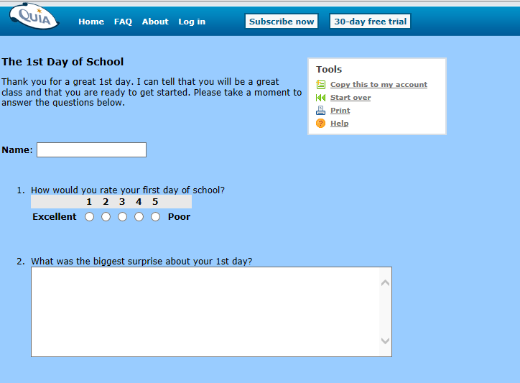
http://www.cbsd.org/jjaffe

Slide 4
August 24, 2015
Components of an Effective Elementary Lesson/Integrating Technology
Jason Jaffe and Suzanne Dailey
First Day Survey
Sample Lesson
General Questions

Slide 5

We are going to listen to a story about someone who is very nervous to do something new. Use clues from the cover of the book to make two predictions about why he/she is nervous. Record your predictions on your paper.

Slide 6
We are going to listen to a story about someone who is very nervous to do something new. Use clues from the cover of the book to make two predictions about why he/she is nervous. Record your predictions on your paper.

Slide 7

We are going to listen to a story about someone who is very nervous to do something new. Use clues from the cover of the book to make two predictions about why he/she is nervous.

Slide 8

As you listen to the story, First Day Jitters, please draw a sketch of what you think Sarah could look like. When the story is done, I will show you how the illustrator, Judy Love, portrayed her.

Slide 9


Slide 10
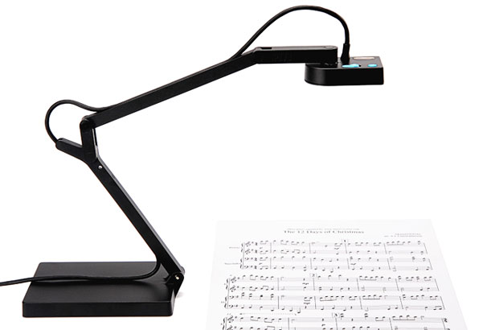
Reflections
As a teacher, how could you use this book
on your first day of school in a lesson integrating technology?

Slide 11


